Slide 1

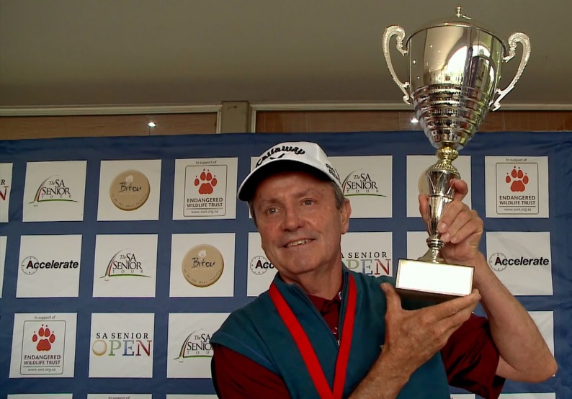





AN EWT SENIOR GOLF SERIES EVENT
PRO-AM HOSPITALITY BROCHURE
2 – 5 OCTOBER 2018
PLETTENBERG BAY COUNTRY CLUB

Slide 2


SA SENIOR OPEN
In just its second year, The SA Senior Open has established itself as the premier event on the new Sunshine Senior Tour. As the only annual Senior professional golf event along the beautiful Garden Route stretch, the SA Senior Open offers a unique opportunity for corporates and individuals to experience tournament golf.
The event will also for the first time, incorporate a special pre event feature on Sunday 30th September, whereby the Annual Mayoral Golf Day will take place, celebrating the alliance between the Senior Tour and Bitou Municipality. Proceeds of this event will go towards the creation of a Golfing Academy, targeting talented youngsters from the surrounding communities.
The SA Senior Open, held from the 2nd to the 5th of October 2018, sees the event return to Plettenberg Bay Golf Course, which is set on a private nature reserve and considered a ‘must play’ course on the Garden Route.
This event brings together Africa’s best Senior Professionals over the age of 50 to compete alongside international Senior Professionals. An exceptional roll call of former Champions including the likes of John Bland and Hugh Baiocchi, will all have the aim of dethroning 2017 Senior Open Champion Mark McNulty.
In support of the EWT, proceeds will be donated to support the endangered Humpback Dolphin.
SA SENIOR OPEN 2018
PAGE 2

Slide 3

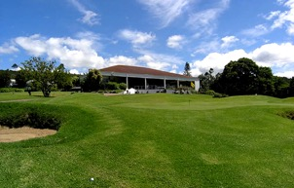


ITINERARY
Sunday 30th of September 2018 (Mayoral Day)
As per Mayoral Golf Day package and details
Tuesday 2nd of October 2018 (Pro-Am day 1)
Receive welcome package at Plettenberg Bay Country Club.
Round 1 with your designated Pro.
Welcome Cocktail Function in the evening at the Plettenberg Bay Country Club.
Wednesday 3rd of October 2018 (Pro-Am day 2)
Round 2 with your designated Pro.
EWT Conservation Function and prize giving in the evening with spit braai at Plettenberg Bay Country Club.
Thursday 4th and Friday 5th (Pros only)
Day 3 and 4, featuring Pros only at Plettenberg Bay Country Club, entrance free.
Alternative golf can also be arranged on day 3 & 4 at one of many other great courses in the area:
Goose Valley Golf Club, Pezula, Fancourt, George CC, Semola
* Bookings will be a made on a separate own cost basis.
SA SENIOR OPEN 2018
PAGE 6

Slide 4


MAYORAL DAY
To celebrate Bitou Municipalities support of the SA Senior Open, the 2 parties decided to incorporate the Annual Mayoral Golf Day into the SA Senior Open as a pre-event.
The events details are as follows:
Will take place on Sunday 30th September 2018
Played at Plettenberg Bay Country Club.
Consist of 120 players, starting a shot gun at 12pm
The event will be a 4ball Alliance
The Senior Tour will ensure that at least 30 of its Pros take part
The weeks official opening function will take place that evening, 7pm at the Beacon Isle Resort
Packages include:
PLAY ONLY - R550 per person
Green fees, caddie, halfway house
Golf shirt and goody bag.
Cocktail function at Beacon Isle.
Sponsored holes form part of the SA Senior Open packages
SA SENIOR OPEN 2018
PAGE 4

Slide 5
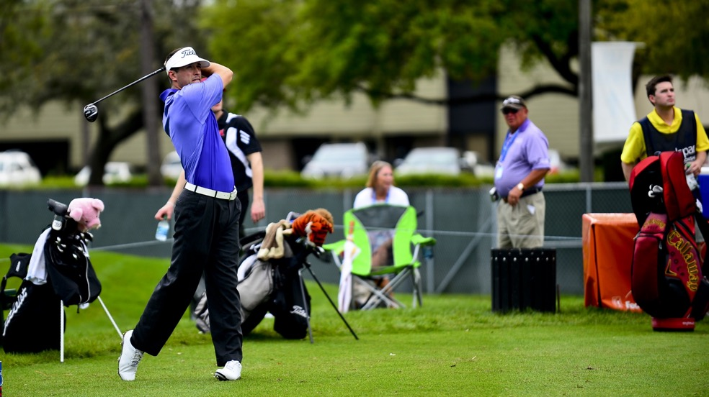

SA SENIOR OPEN EVENT FORMAT
In an effort to bring fans and golfers closer to the action, the SA Senior Open begins with a 2 day Pro-Am, with 60 Senior Pros and 60 Amateurs competing.
The Pros scores will count towards their final event score, making every shot vital.
The final day will feature only the Pros, where they will battle it out for their share of the R500,000 prize fund.
SA SENIOR OPEN 2018
PAGE 3

Slide 6
PACKAGES
Pro-Am packages are available for individuals or teams. Slots are limited to 60 players per day.
PLAY ONE DAY
R750 per person
PLAY BOTH DAYS
R1,400 per person
One entry for both days, 36-hole Pro-Am.
Chance to play with 2 Senior Tour Pros per day.
Includes green fees, halfway meal and a drink.
A choice of caddy or a cart.
Preferential tee-off time.
Commemorative tournament gift package for each day.
Exclusive event Golf Shirt and Cap for each day.
Invitations for two to the Welcome Function.
Invitations for two to the EWT Cocktail Function.
Team photograph signed by your Professional.
Prizes and Certificates for the Top 10 Finishers.
One entry into 1-day, 18-hole Pro-Am.
Chance to play with 2 Senior Tour Pros.
Includes green fees, caddy, halfway meal and a drink.
Commemorative tournament gift package.
Exclusive event Golf Shirt and Cap.
Invitations for two to the Welcome Function.
Commemorative Team photograph.
Prizes and Certificates for the Top 10 Finishers.
*All prices are VAT inclusive.
SA SENIOR OPEN 2018
PAGE 7

Slide 7

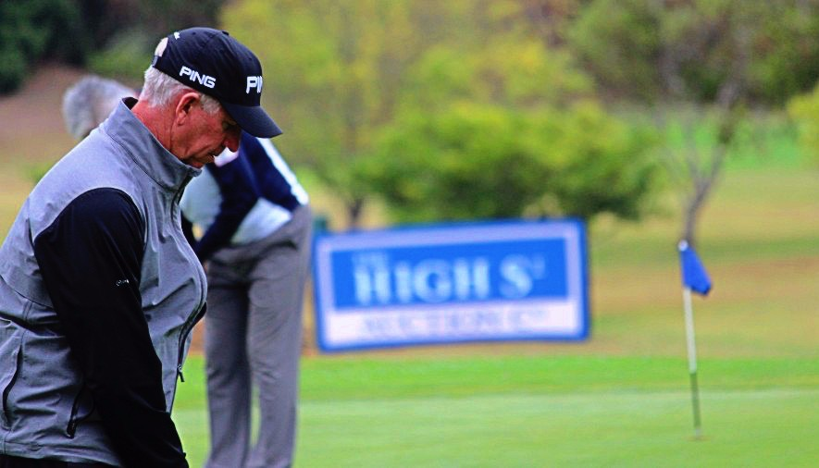

HOLE SPONSORSHIP
R25,000 Excl. VAT
Hole sponsorship provides an opportunity to generate exposure for your brand at the event as well as through the SuperSport Broadcast production.
Hole selection is on a first come, first serve basis.
KEY BENEFITS INCLUDE BUT NOT LIMITED TO:
Branding placement at ONE selected hole for both the Mayoral Day and SA Senior Open event – 6days (including practice day).
Branding: 2 boards at Tee-box, 4 more across Green and Fairway.
2 Hospitality packages: both Pro-Am and Mayoral days.
Activation opportunity around your sponsored hole.
Official mention in the event program & website.
Opportunity for collateral in gift packs.
2 Exclusive tickets to the Cocktail Function and Conservation Dinner.
Exclusivity in area of business.
Marketing and IP Rights.
*Excludes VAT and branding production cost.
SA SENIOR OPEN 2018
PAGE 8

Slide 8

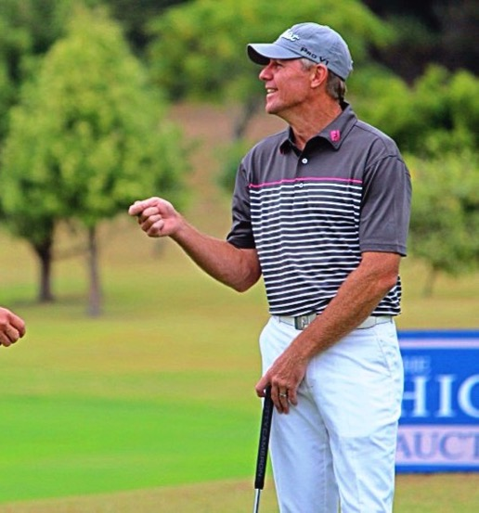





AN EWT SENIOR GOLF SERIES EVENT
For further information or to book, please contact:
Daniel Quinta – Accelerate Sport
083 308 6682 or daniel@acceleratesports.com
Or visit www.acceleratesport.com

